Slide 1
Welcome to my presentation
Jannatul ferdous umama
Id 20-42616-1
Sl 25

Slide 2
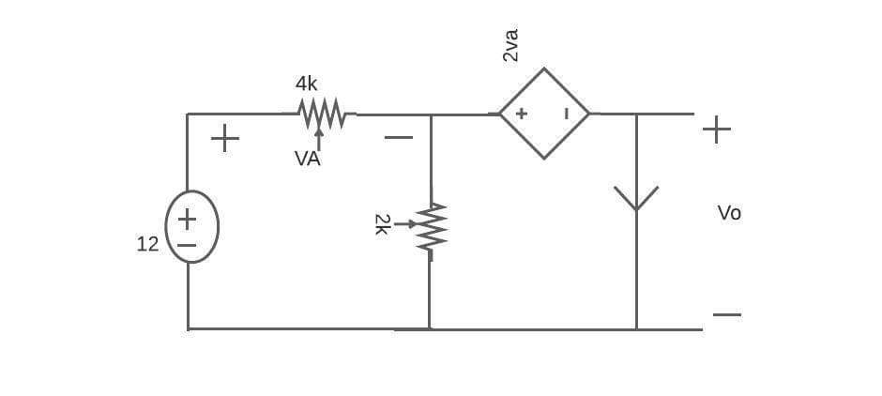
Thevenin’s Equivalent with dependent and independent source
If there is both the dependendent source and the indeoendent source is available then we have to follw step by step to solve the circuit. In this picture there is a dependent source as well as a independent source.
Jannatul ferdous umama
Id 20-42616-1
Sl 25

Slide 3
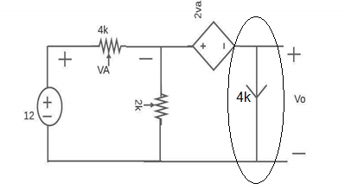
Processe’s step by step
Identify the load current
Jannatul ferdous umama
Id 20-42616-1
Sl 25

Slide 4
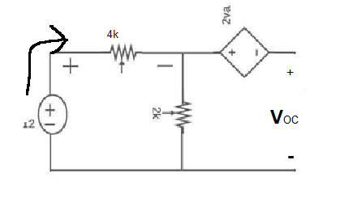
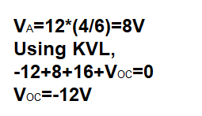
Remove the load and then calculate Open circuit voltage
Jannatul ferdous umama
Id 20-42616-1
Sl 25

Slide 5
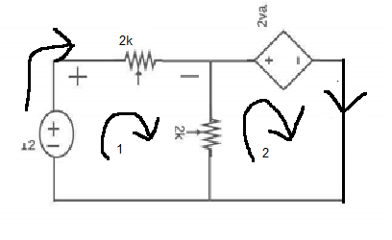
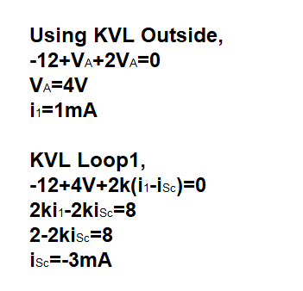
Calculate the short circuit voltage
Jannatul ferdous umama
Id 20-42616-1
Sl 25

Slide 6
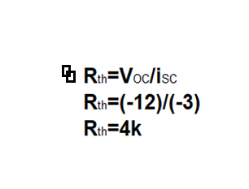
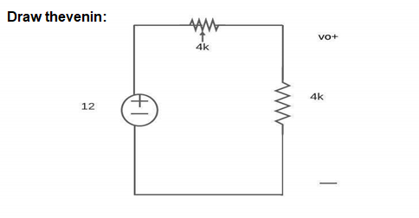
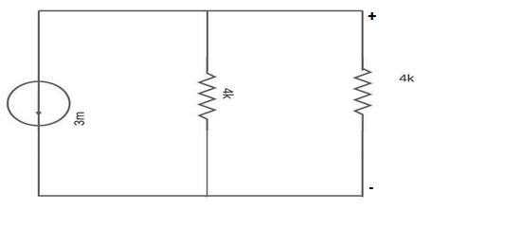
Apply the kVL for the circuit
Jannatul ferdous umama
Id 20-42616-1
Sl 25

